Slide 1
Product, Inventory and Order Management
{
B073 Krishna Gujrati, B074 Samridhi Raj Sinha, B082 Asmi Parikh and B083 Surya Vemuri
}
...

Slide 2
Table of contents
01
02
03
Problem Statement
Basic Project idea and what we’re implementing
Our Proposed Solution
Overview and explanation about the project
Code
Explanation of codes and major functions that were implemented

Slide 3
01
Problem Statement
{
..
Basic Project idea and what we’re implementing
}
..

Slide 4
Problems We Solved
Traditional monolithic systems are tightly coupled, making scalability and maintenance difficult.
Managing product information, stock levels, and customer orders from a single codebase can lead to performance bottlenecks.
Lack of flexibility in handling service failures or integrating with third-party systems.
Difficulty in scaling individual components independently (e.g., scaling Inventory logic during peak sales).
}
..

Slide 5
02
Proposed Solution
{
..
}
..

Slide 6
Proposed Solution
*
Modular Architecture: Split into three independent microservices — Product, Inventory, and Order.
Spring Cloud OpenFeign: Enables clean and easy communication between services.
Service Discovery with Eureka: Allows dynamic service registration and discovery.
API Gateway: Provides a single entry point, simplifying client interaction and enabling centralized routing.
Database Isolation: Each microservice handles its own data and logic — improves decoupling and resilience.

Slide 7
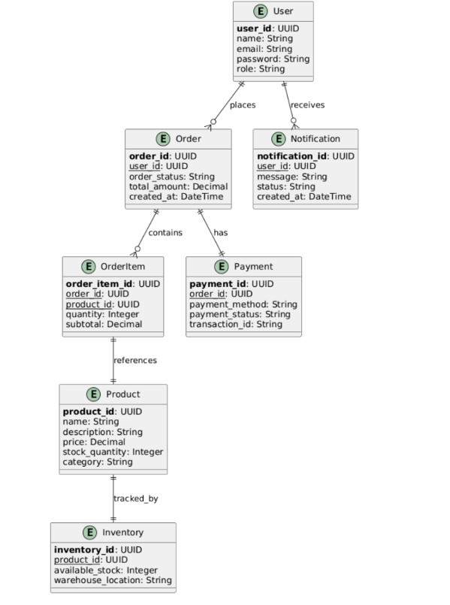
System Architecture
*
Our system follows a microservices architecture using Spring Boot and Spring Cloud, enabling independent deployment and scaling of each service.
Components:
API Gateway
Single entry point for client requests
Routes requests to appropriate microservices
Simplifies security, logging, and monitoring

Slide 8
System Architecture
*
Eureka Server (Service Registry)
Enables dynamic service registration and discovery
Microservices register themselves and discover others dynamically
Product Service
Manages product data (name, description, price, SKU)
Communicates with Order Service via OpenFeign
Inter-Service Communication:
Spring Cloud OpenFeign is used for declarative REST client communication.
API Gateway routes requests like /products, /orders, and /inventory to the respective services.

Slide 9
System Architecture
*
Inventory Service
Manages stock levels and availability
Checks if requested quantity is available during order placement
Order Service
Handles creation and management of customer orders
Calls Product and Inventory services via Feign clients
Places order only if stock is available and product exists
Databases (MySQL)
Each microservice uses its own database for data isolation and autonomy

Slide 10
03
Code
{
..
Detailed explanations of the three services: Product, Inventory and Order Service
}
..

Slide 11
Product Service
The Product Service is responsible for managing all product-related data in the system. It handles product creation, retrieval, update, and deletion, and supports fetching product information by SKU code.
Workflow Summary
Client sends a request via API Gateway to /products endpoint.
ProductController handles the request and delegates to the ProductService.
ProductService performs logic and interacts with ProductRepository.
Repository talks to the MySQL Database to perform data operations.
Responses and errors are properly formatted and returned.
*

Slide 12
Product Service
Product.java
Service Layer
Repository Layer
...
Model Layer (Product.java)
Represents the product entity.
Annotated with @Entity to map it to a MySQL table.
Fields:
id: Auto-generated primary key.
skuCode: Unique identifier for the product.
description: Product details.
price: Cost of the product.
Contains business logic for managing products. Methods:
getAllProducts() – Fetches all products.
getProductById(Long id) – Fetches product by ID.
createProduct(Product product) – Saves a new product.
updateProduct(Long id, Product product) – Updates product details.
deleteProduct(Long id) – Deletes a product.
getProductBySkuCode(String skuCode) – Finds a product by SKU code.
Interface extending JpaRepository.
Provides CRUD methods for the Product entity.
Adds custom method:
Optional<Product> findBySkuCode(String skuCode)

Slide 13
Product Service
Controller
Swagger API
Exposes RESTful endpoints:
GET /products – Retrieve all products.
GET /products/{id} – Retrieve by ID.
POST /products – Create a product.
PUT /products/{id} – Update product.
DELETE /products/{id} – Delete product.
GET /products/sku/{skuCode} – Fetch by SKU code.
Handles exceptions using ProductNotFoundException.
Exception Handling
...
Configures OpenAPI (Swagger) for auto-generating API documentation.
Title: Product Service API
Custom exception to handle cases where product is not found.
Returns HTTP 404 (Not Found) status.

Slide 14
Order Service
The Order Service is a core component of the microservices architecture responsible for:
Creating, retrieving, and deleting customer orders.
Validating product existence via the Product Service.
Verifying stock availability via the Inventory Service.
Communicating with external services using Feign Clients.
Communication Flow
User sends POST /orders request.
OrderService → ProductClient: verifies product existence.
OrderService → InventoryClient: checks stock.
If both checks pass, order is saved using OrderRepository.
✅ Features
Loose coupling via Feign clients.
Centralized API documentation with Swagger.
Clean separation of concerns (Controller-Service-Repo).
Graceful error handling for stock and product validations.
*

Slide 15
Order Service
Product.java
Service Layer
Repository Layer
...
Represents the structure of an order stored in the orders table.
Fields include order ID, SKU code (product ID), and quantity.
Validates:
✅ Product existence via ProductClient
✅ Stock availability via InventoryClient
Saves order to the database only if both checks pass.
Handles database operations using Spring Data JPA.
No custom methods needed as standard CRUD is sufficient.

Slide 16
Order Service
Controller
Swagger API
API Endpoints:
GET /orders → List all orders
GET /orders/{id} → Retrieve specific order
POST /orders → Create new order after validations
DELETE /orders/{id} → Remove order
DTO
...
Enables auto-generated Swagger UI docs at /swagger-ui.html.
Captures product details received from the Product Service.
Used internally in the Order Service during validation.

Slide 17
Inventory Service
The Inventory Service is a crucial backend microservice responsible for managing the stock of products. It interacts with the Order Service to:
Validate if a product exists in inventory.
Check if there is sufficient quantity available before allowing orders.
🔄 Communication Flow
Order Service sends a request to /inventory/stock.
Inventory Service fetches item by SKU.
If item exists and quantity >= requestedQuantity, returns true.
Otherwise, returns false.
✅ Features
Real-time inventory check per SKU.
Seamless integration with Order Service.
Validation to prevent overselling.
API documentation with Swagger/OpenAPI.
Clean, modular structure following best practices.
*

Slide 18
Inventory Service
Product.java
Service Layer
Repository Layer
...
Represents an inventory item stored in the database.
Key fields:
skuCode: unique product identifier.
quantity: number of items in stock.
Core logic to check stock availability.
Ensures quantity is equal to or greater than the requested amount.
Other service methods:
Retrieve all inventory items.
Save or delete inventory records.
Fetch inventory by ID.
Leverages Spring Data JPA for CRUD operations.
Includes a custom method to query inventory by SKU code.

Slide 19
Inventory Service
Controller
Swagger API
...
Exposes RESTful endpoints:
GET /inventory – List all inventory.
GET /inventory/{id} – Get item by ID.
POST /inventory – Add a new inventory item.
DELETE /inventory/{id} – Delete an item.
POST /inventory/stock – Check stock by SKU & quantity (used by Order Service).
Automatically generates interactive API docs.
Accessible via Swagger UI for easier testing and integration.

Slide 20
04
Outputs
{
..
Outputs of the Services implemented
}
..

Slide 21
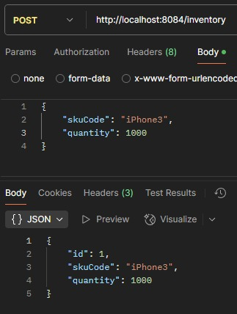
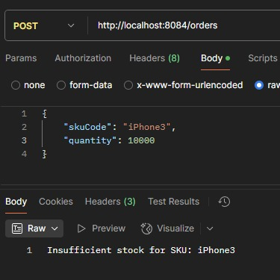
Proposed Solution
*

Slide 22
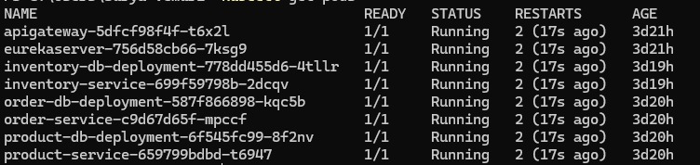
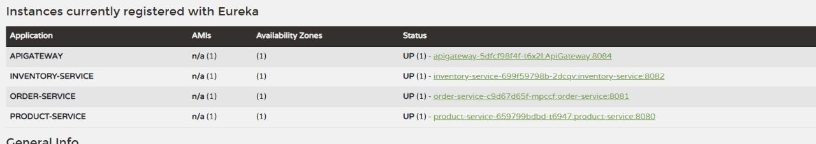
Proposed Solution
*

Slide 23
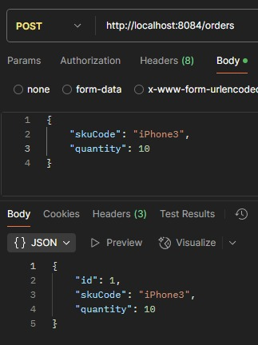
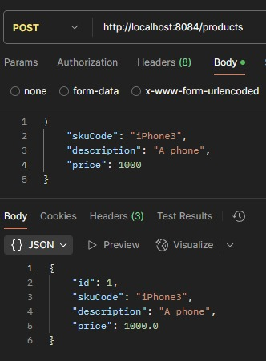
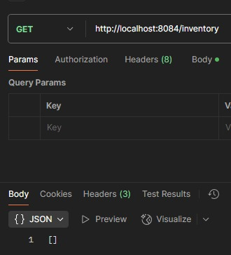
Proposed Solution

Slide 24
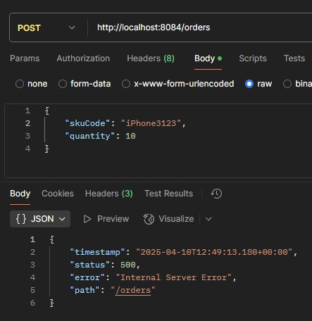
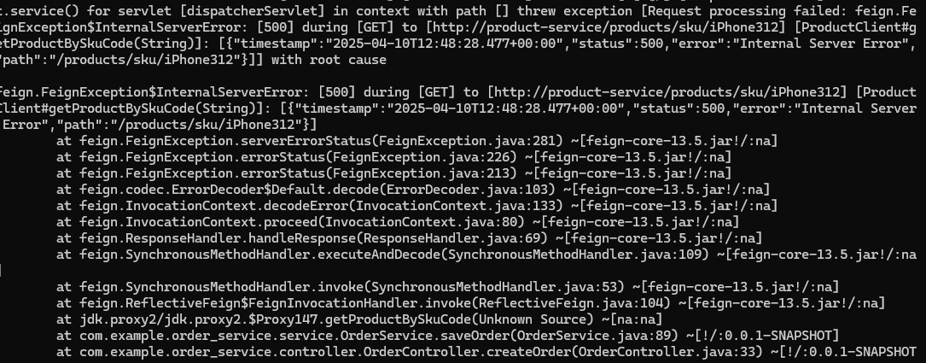
Proposed Solution

Slide 25
Thank
You
{
..
}
..

